Slide 1
New Goal System (NGS-4) TankSoar example Timothy W. Saucer, Ph.D.

Slide 2
Environment Setup
Unpack the soar tutorial
In the directory containing TankSoar launch file (.command, .bat, or .sh) create a file called settings.soar with the line:
cli tcl on
Install the Soar IDE for eclipse (optional, but recommended)
https://github.com/soartech/soaride
Clone NGS-4 into your working folder
https://github.com/soartech/new-goal-system-4
Note: This is an updated link. The old new-goal-system repository does not contain NGS-4.
First load in soar must process the macros
source "new-goal-system-4/load.soar”
jSoar - not for TankSoar, but useful debugger

Slide 3
What is NGS-4? (New Goal System version 4)
One approach to setting up a goal forest in soar
Cool features such as function operators and dynamic binning
A ton of useful macros
Some people think of it as a high level language that runs on soar
A great topic for dinner conversations with your in-laws

Slide 4
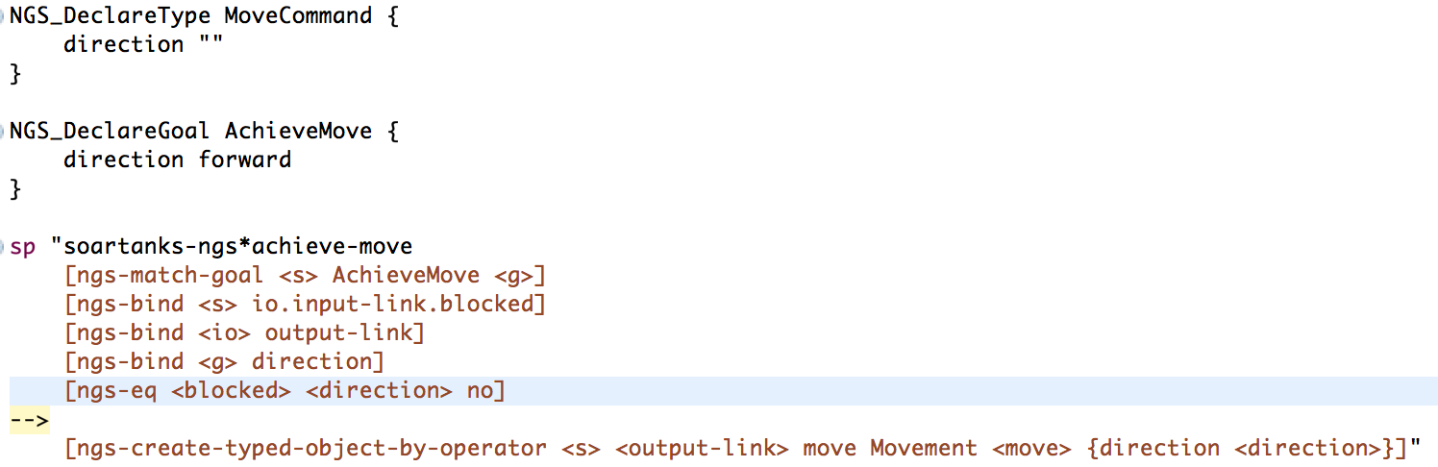
Anatomy of NGS Commands
All commands begin with [ngs-
RHS and LHS macros defined in rhs-fragments.soar and lhs-fragments.soar
Must use “ “ to enclose soar production
Note: Regular soar production lines can be used (but should not be necessary)

Slide 5
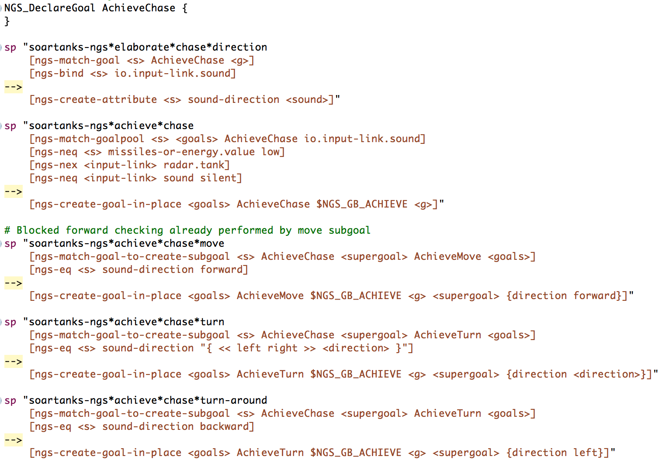
TankSoar Chase example

Slide 6
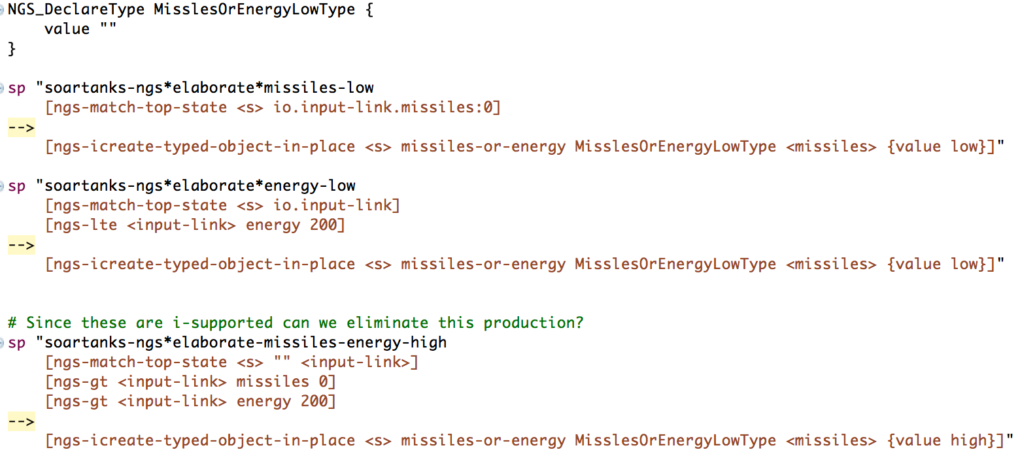
Using Declared Types
Declaring types allows for simple collections of data similar to a c++ struct
There is no type checking, no guarantee data exists, no inheritance
Simple data storage, but very useful for populating output

Slide 7
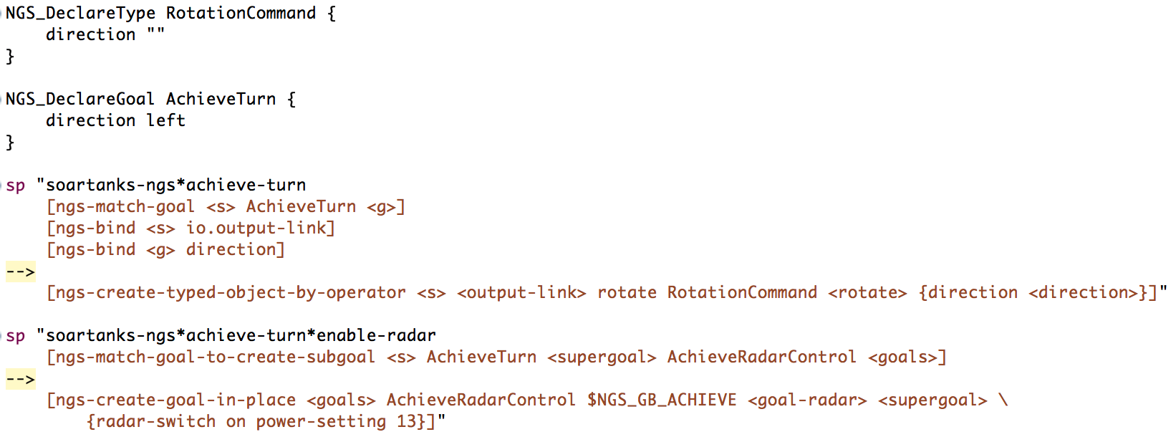
Declaring Goals
Original intent of NGS was to define a new goal system (hence the name)
Goals may have subgoals and supergoals
Goals MUST be defined using NGS_DeclareGoal
In this example, the goal is to achieve a turn. This goal will create a rotation command on output-link.rotate containing the direction data.

Slide 8
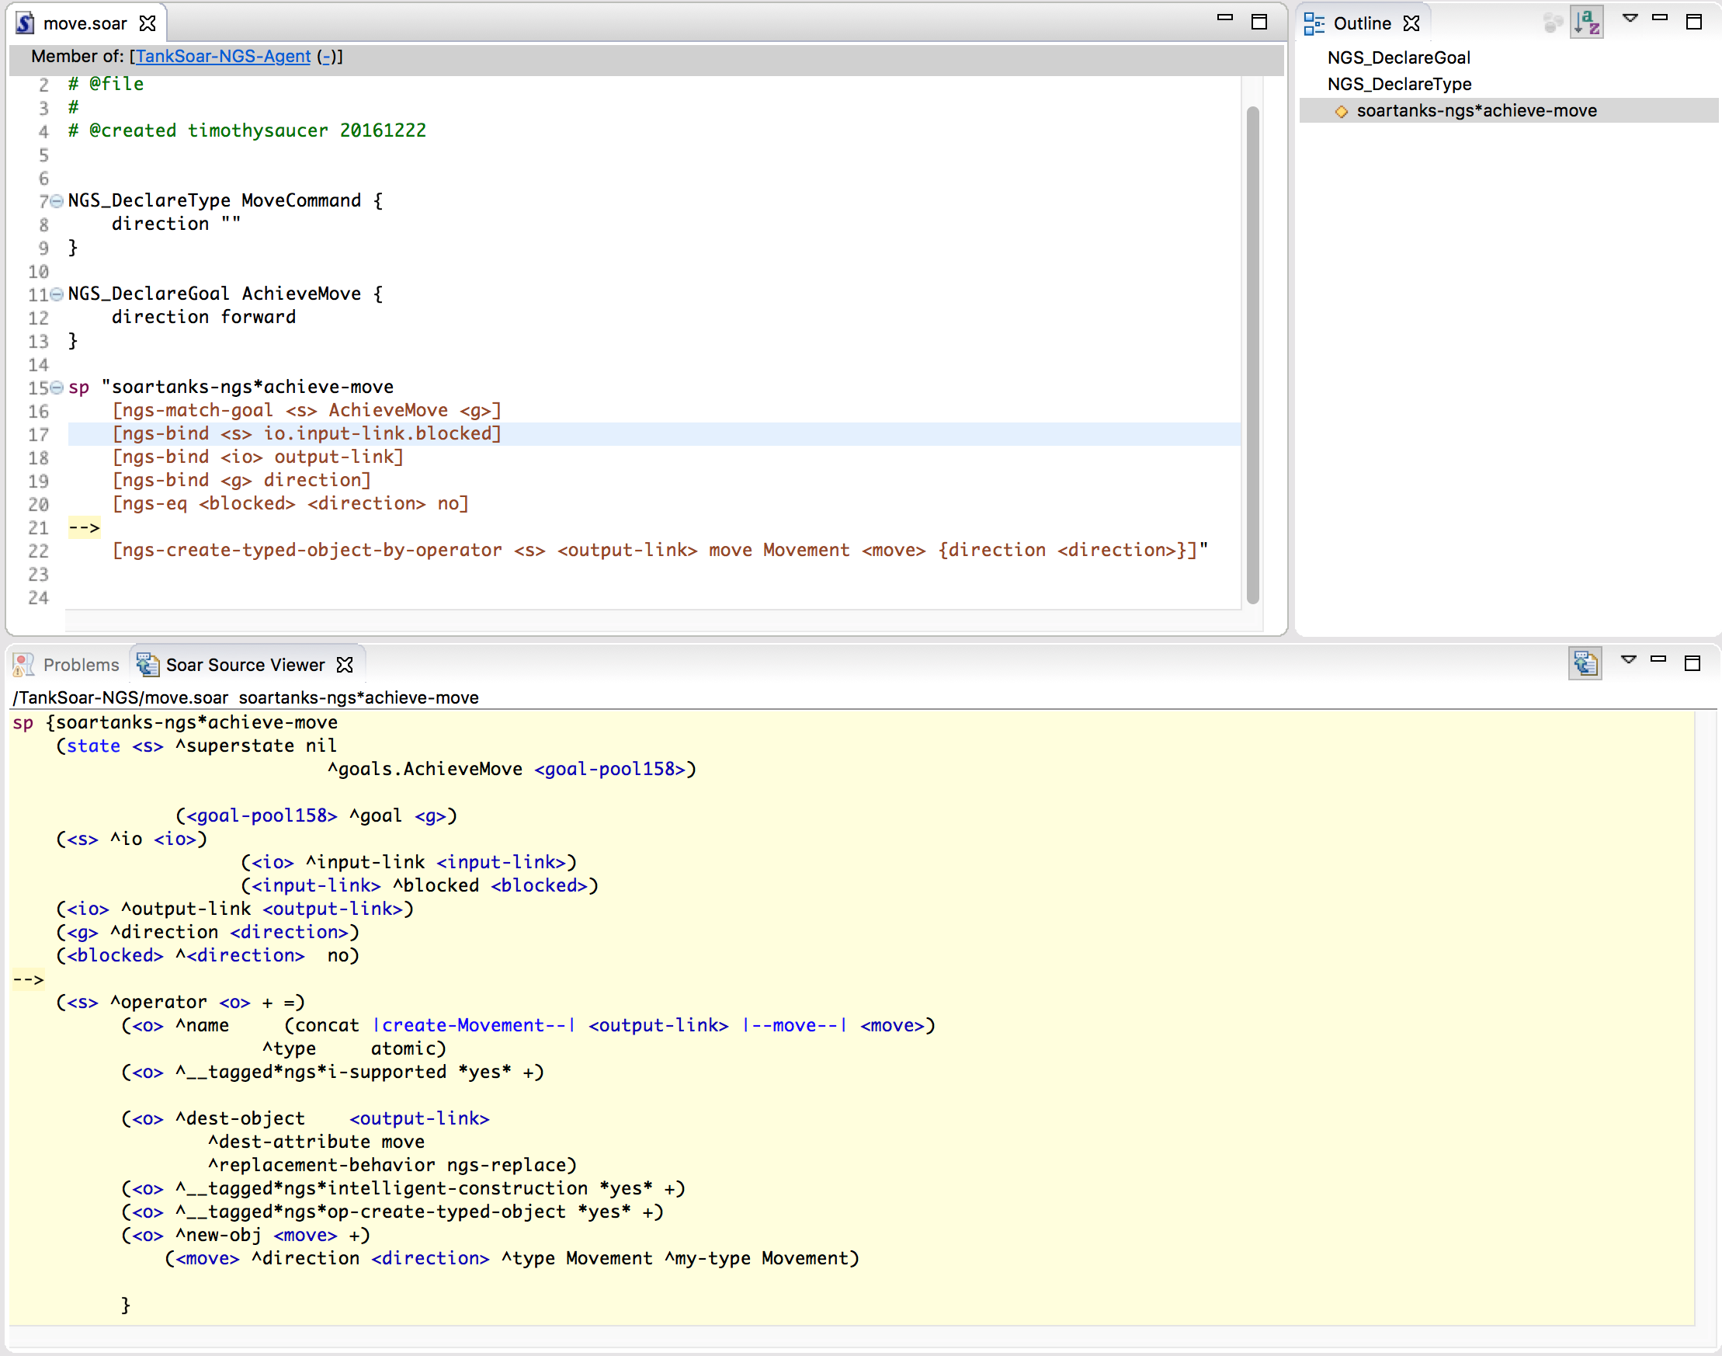
Soar IDE Expansion

Slide 9
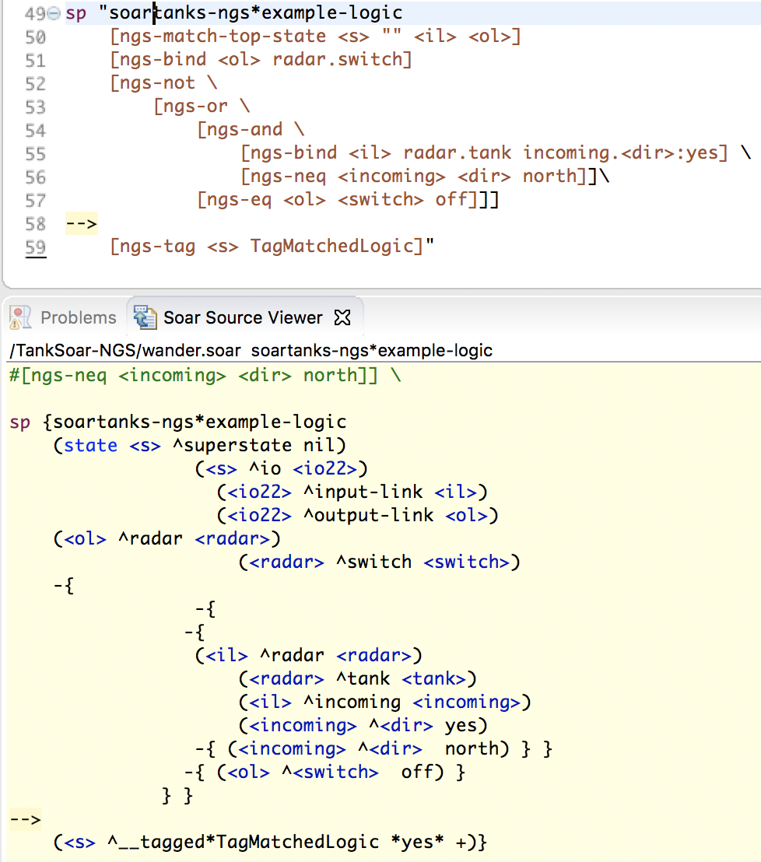
Building complex logic in NGS-4
NGS-4 is great at complex logic
Macros available include
ngs-not ngs-and nsg-or
ngs-is-tagged
ngs-eq ngs-neq
ngs-anyof (only works with constants, not variables)
ngs-this-is-not-that
ngs-is-type ngs-is-not-type
ngs-is-named
ngs-is-my-type
ngs-is-active
Check lhs-fragments.tcl for more

Slide 10
Creating objects (WMEs)
Creating objects and tags are simple in NGS-4
O-Supported simple WME
I-Supported simple WME:
Tag (i-Supported):
O-Supported Typed Object:
I-Supported Typed Object:
A single production! No propose/apply needed
These details are a common source of error and taken care of by NGS

Slide 11
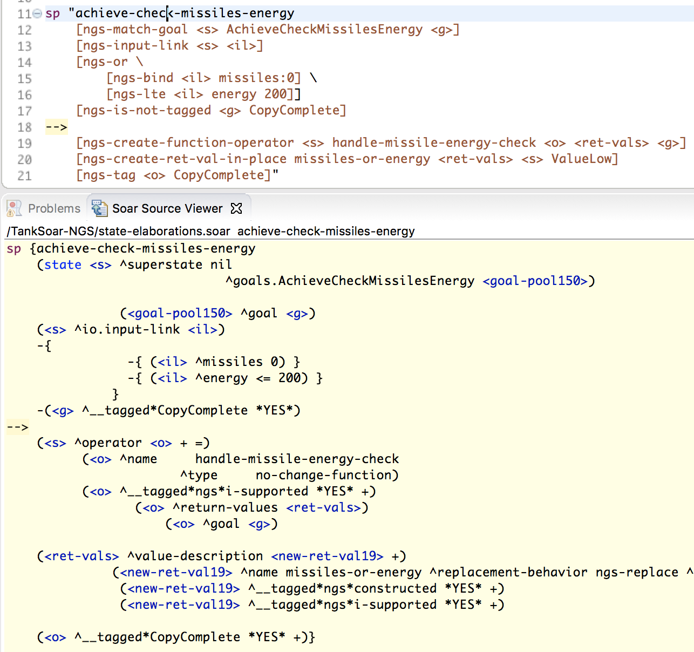
Function Operators
Simple operators that trigger an operator no change
They’re like a little function… operator
Useful for manipulating data
The work is done in a substate
So how does the copied data get back to the main state if it’s generated in a substate?
Function operators can have return values!

Slide 12
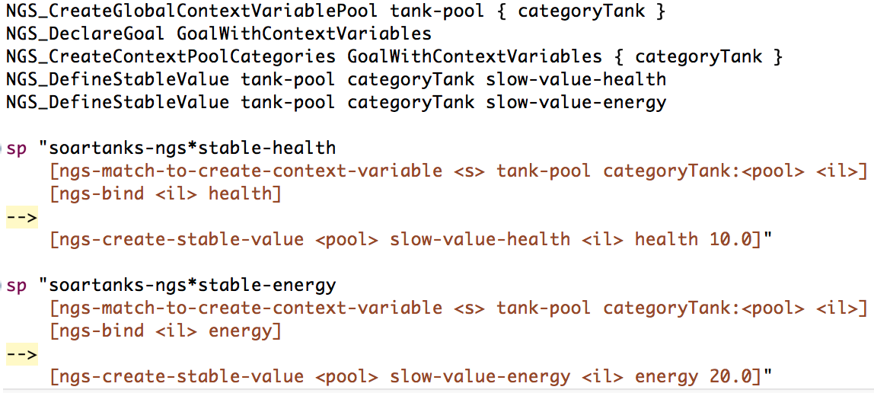
Context Variables
Data describing the context of a decision
Useful macros exist for binning data, creating time delayed data, etc
Improves performance by not sampling changing variables too quickly
Note: Pool name must be specified in match line (otherwise auto generated and not intuitive)
Dynamic binning currently supported (and often best used in practice)
Could use large bins when energy/health are high, small bins when low

Slide 13
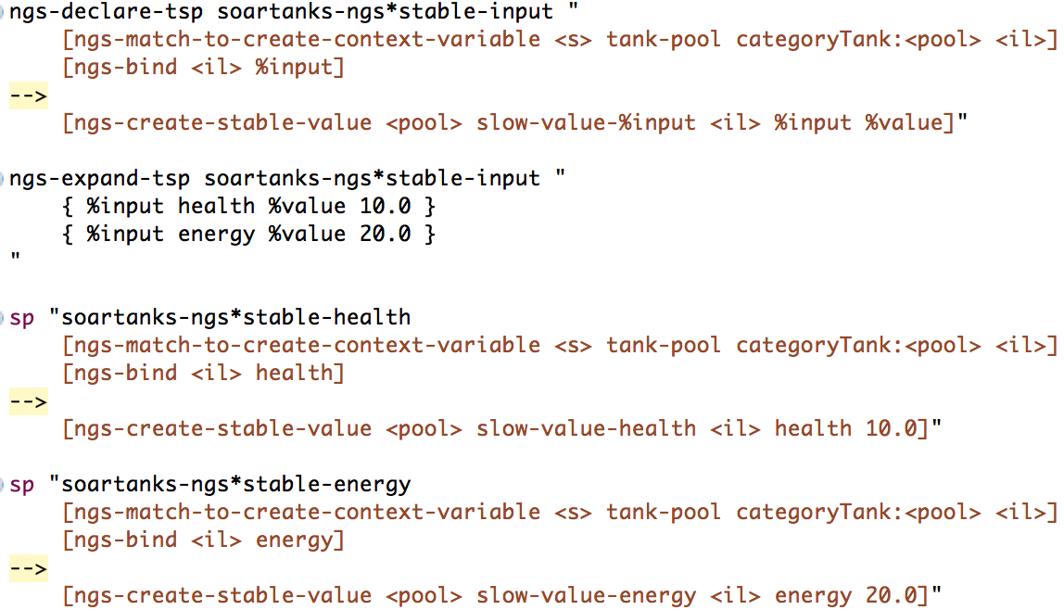
BYOM (Build Your Own Macros)
Use ngs-declare-tsp and ngs-expand-tsp to create / use macros
Unique production name will be generated based on macro name and input parameters
Soar IDE source viewer expansion will not display raw soar code

Slide 14
Nuggets and Coal
Excellent way to simplify many sections of code
Logic, data structures
Useful binning mechanisms
Can write many rules with few lines of code
Powerful macros
Open Source
Requires learning new way to write soar code
Not all expansions are supported by Soar IDE
Some features have unique quirks (ie: pool names in context variables)

Slide 15
Questions?

